Slide 1
Beer Classification : Recommendation using user feedback

Slide 2

Research Questions
With rating from the Dr.Ousley, how well can the model cluster Dr.Ousely with similar user and recommend Dr.Ousley with beer.

Slide 3
About the Data set
Original Dataset size
1,580,487 observation & 13 variables
Reducing the sample to top 20 reviewer
After adding Dr.Ousley rating to the data set
84,387 observation & 8 variables

Slide 4
Nature of predictors
X(Continuous)
brewery_id(Continuous)
brewery_name(Nominal)
beer_style(Nominal)
beer_beerid(Continious)
beer_name(Nominal)
review_overall(Ordinal)
review_profilename(Factor)

Slide 5
Method : Clustering
Unsupervised Learning
Hierarchical clustering: agglomerative
Estimating relationships among all groups (membership known)
Similar to DFA (supervised learning)
Relationships among all individuals (membership known/assigned)

Slide 6
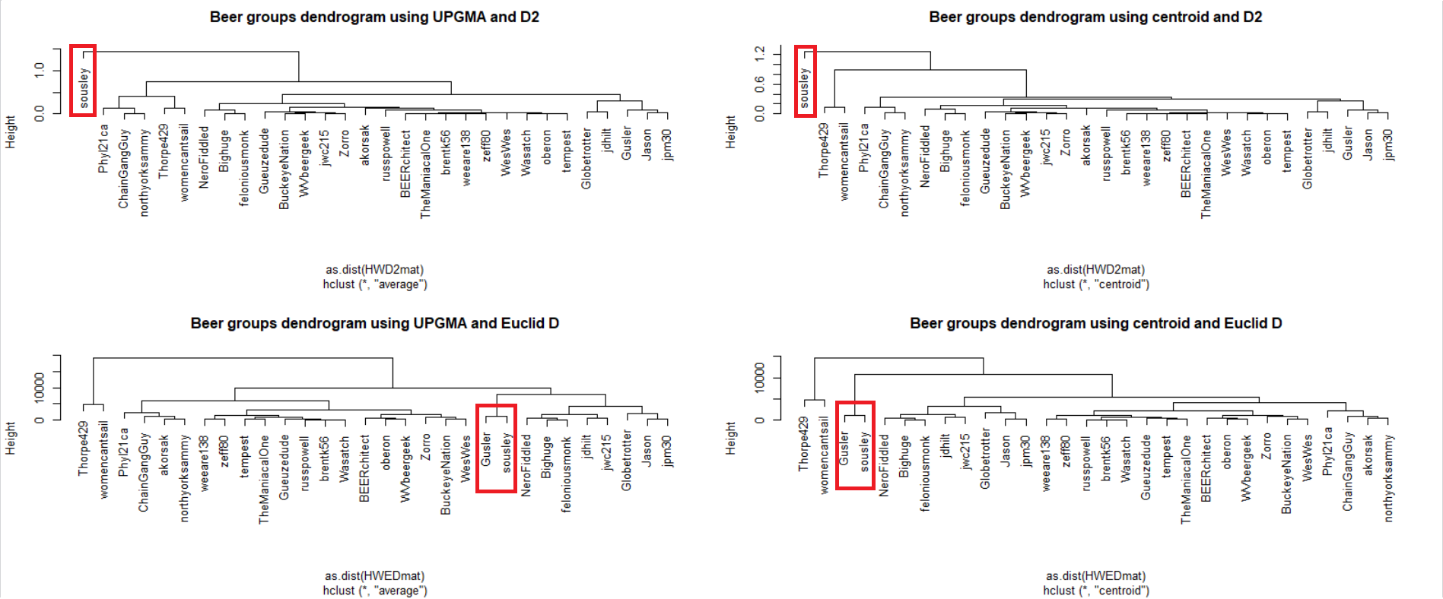
Results

Slide 7
Conclusions
Better classification
UPGMA with Euclidean distance
Centroid with Euclidean distance
Not So good classification
UPGMA with D2
Centroid with D2

Slide 8
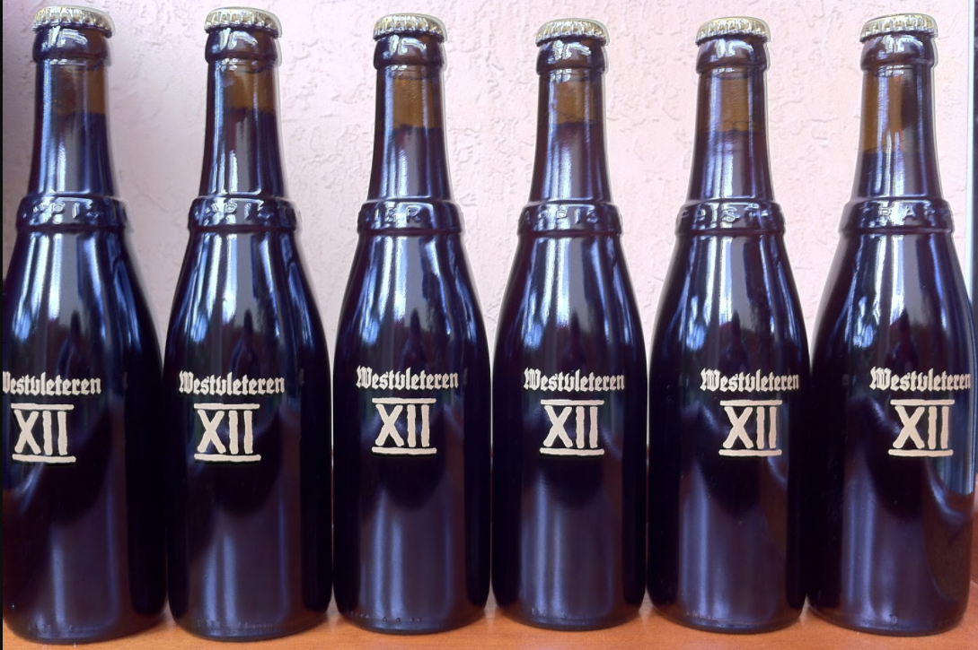
Final Recommendation Trappist Westvleteren 12

